Slide 1
FCC Accessible Communications Regulations
Accessibility D.C.
February 18, 2014
Presented by Sam Joehl

Slide 2

Agenda
Communications accessibility laws overview
Covered entities, services and equipment
Requirements governing design and development
Recordkeeping and reporting requirements
Real world implementation

Slide 3
Legal Overview

Slide 4
Legal Overview
Congress passed the 21st Century Communications and Video Accessibility Act of 2010 (CVAA) which:
Focuses on ensuring that new forms of communication and video are accessible to users with disabilities.
Primarily targets broadband service providers, software and equipment manufacturers, video programming distributors and producers of video content.
Requires that much of the communications and video programming that passes over the Internet is provided in an accessible manner to individuals with disabilities.

Slide 5
Legal Overview: CVAA Organization
Title I – Communications Access
  Broken down into six parts
  Primarily amends the Communications Act of 1934
  Significant item of note is the Advanced Communication Services requirements of Section 716 and Recordkeeping Requirements of Section 717
  Rulemakings on these sections are largely completed and rules are currently effective
Title II – Video Access
  Also broken down into six parts
  Focuses on ensuring video delivery systems are accessible
  Rulemakings on this section mostly complete

Slide 6
Legal Overview: CVAA: Title I
Title I – Communication Access
Section 101 – Definitions
Section 102 – Hearing Aid Compatibility
Section 103 – Relay Services (fund extended to VoIP)
Section 104 – Access to Internet-based services and equipment
  Establishes § 716 of Communications Act, which requires access to Internet based communication services and equipment.
  Establishes § 717 of Communications Act, which defines recordkeeping rules for Sections 255, 716 and 718.
  Establishes § 718 of Communications Act, which requires mobile phone browsers to be accessible to blind or visually impaired persons
Section 105 –Relay Services for deaf-blind individuals
Section 106 –Emergency Access Advisory Committee

Slide 7
Legal Overview: CVAA: Title II
Section 201 – Video Programming and Emergency Access Advisory Committee
Section 202 – Video description and closed captioning
Section 203 – Closed captioning decoder and video description capability
Section 204 – User interfaces on digital apparatus
Section 205 – Access to video programming guides and menus on navigation devices
Section 206 - Definitions

Slide 8
CVAA Section 104
Section 716 requires equipment manufacturers and service providers to make ACS, including the enabling software for such ACS, accessible to and usable by persons with disabilities (including persons who are blind and visually impaired, deaf or hearing impaired, physically or cognitively disabled, including a combination of any of these), if achievable, or if not, compatible with existing assistive technologies, if achievable.
Section 717 imposes new record keeping requirements and enforcement rules on ACS and Section 255 Services
Section 718 requires accessibility of mobile browsers

Slide 9
FCC Rules Implementing 716-718:
47 CFR Part 14
Subpart A – Scope
Subpart B – Definitions
Subpart C - Obligations
  Accessible to and usable by individuals w/disabilities or compatible with existing devices
  No impediment of accessibility or usability
  Incorporation in product design and development
  Information pass through
  Information, documentation and training
    Call centers
    Print mailing
    Web support
  Performance objectives
Subpart D - Recordkeeping and Complaints

Slide 10
Communications Act Section 255:
Telecom and Interconnected VoIP
The CVAA also reinvigorated Section 255 of Communications Act
Section 255 requires accessibility of telecom and interconnected VoIP services and equipment, call status features and voicemail/interactive menus:
  Applied to telecom, features, VM and menus in 2000
  Extended to interconnected VoIP effective October 2007
Includes similar accessibility, usability and compatibility requirements
Standard is “readily achievable”- easily accomplished without much difficulty or expense
Recordkeeping and enforcement provisions updated to be same as adopted for ACS

Slide 11
FCC Rules Implementing Section 255:
47 C.F.R. Parts 6 and 7
Part 6: Telecommunications and Interconnected VOIP services (including call features such as call forwarding) and CPE
  Subpart A: Scope
  Subpart B: Definitions
  Subpart C: Obligations
  Subpart D: Enforcement
Part 7: Voicemail and interactive menu services and equipment
  Same subpart structure

Slide 12
Coverage and Scope

Slide 13
Covered Entities: ACS Defined
Interconnected VoIP not covered by Section 255 and non-interconnected VOIP
Electronic Messaging Services –real time or near real time non-voice messages in text between individuals over communications networks, e.g., emails, texts (not blog or on-line posts on social networking sites, human- or machine- to machine communications, or customized enterprise service)
“Interoperable” video conferencing services that provide real time video communications, including audio, to enable sharing of information
Part 14, Subpart B

Slide 14
Covered ACS Examples
Products or services that provide text messaging, instant messaging, e-mail or other text based communication
  Web-based email, G-mail, Outlook web client, AOL Instant Messenger, iMessage, web based chat and portions of web sites that provide communication services like Facebook’s message service and related equipment – laptops, phones, tablets, set top boxes and gaming devices
Products or services that provide non-interconnected VoIP based communication
  Skype, Google Talk, Facebook Chat or any other chat services
Products or services that provide video based communication
  Skype, Google hangouts and Facetime
  Webinars and other products that allow for real-time video communication over the Internet
Products or services that provide access to covered communication services
  Internet browsers
  E-mail and messaging clients, i.e., Microsoft Outlook and AOL instant Messenger

Slide 15
Responsibility for ACS Accessibility
Manufacturers of ACS end user equipment, network equipment and component software
ACS provider interpreted broadly to include all entities that make ACS available in any manner
  E.g. those that make web based email available, those that provide non-interconnected VoIP services through applications that consumers download to their devices; those that provide texting services over cellular networks; providers of software that gives consumer ability to send and receive email, text messages or non-interconnected VoIP

Slide 16
Covered Entities: Section 255 Defined
Telecommunications Service Providers
  Voice Service, Call Features, Voicemail, Menus
Telecommunications Equipment and CPE Manufacturers
Interconnected VoIP Service Providers
  Voice Service, Call Features, Voicemail, Menus
Interconnected VoIP Equipment and CPE Manufacturers

Slide 17
Covered Section 255 Examples
Landline Telecom Carriers
  Verizon and AT&T
Fixed line, mobile or VOIP phones
  iPhone, Samsung Galaxy, Polycom VOIP Phone, Touch Tone Phones
Products or services that provide IP voice based communication and connect to PSTN
  Comcast, Charter, Vonage, Google Talk

Slide 18
Responsibility for 255 Compliance
Communications Providers - includes all entities that make communications services available, including resellers and aggregators, and providers of software that gives consumers the ability to use communications (e.g., send/receive email or texts), such as user interfaces and browsers
  Wholesale providers (e.g. IBBS/ALEC) and branded service resellers; FCC Form 499 Filers
Communications Equipment Manufacturers - includes those that make or produce end user equipment, network equipment and software used for communications including the device and its operating system, user interface, application, network services, accessibility API and technology, and browser
  Firefox Thunderbird Messaging Client, Google Talk Client, AOL Instant Messenger

Slide 19
Requirements

Slide 20
Nature of Accessibility Requirement
47 CFR14.20: covered ACS must be “accessible to and usable by” persons with disabilities, if achievable
Can be built in or use third party solution available at nominal cost and supported
If not achievable, must be compatible, if achievable
Pass Through – Network platforms and pass-through systems are responsible for ensuring that any standard accessibility information is maintained and not stripped out

Slide 21
Requirements: Accessible
Accessible means that the input, control and mechanical functions of a covered service or device are locatable, identifiable and operable in accordance with FCC performance objectives.
The FCC measures accessibility using 10 performance objectives geared toward specific disabilities defined in 47 CFR 14.21.
User interface must also meet 9 criteria
These performance objectives are the same as those defined for Section 255 requirements
Performance objectives go well beyond user modalities defined in Section 508 requirements.

Slide 22
FCC Accessibility Performance Objectives
Section 14.21(b)(1) defines accessible as
(i) Operable without vision
(ii) Operable with low vision and limited or no hearing
(iii) Operable with little or no color perception
(iv) Operable without hearing
(v) Operable with limited manual dexterity
(vi) Operable with limited reach and strength
(vii) Operable with a Prosthetic Device
(viii) Operable without time-dependent controls
(ix) Operable without speech
(x) Operable with limited cognitive skills

Slide 23
FCC User Interface Requirements
Section 14.21(b)(2): Information necessary to operate and use covered products (such as text, images, icons, labels, sounds or cues) must ensure:
  Availability of visual information (for blind)
  Availability of visual information for low vision users
  Access to moving text
  Availability of auditory information (for deaf)
  Availability of auditory information for hard of hearing
  Prevention of visually induced seizures
  Availability of audio cut off
  Non-interference with hearing technologies
  Hearing Aid Coupling

Slide 24
Requirements for Design/Development
Part 14, Rule 14.20(b) requires
  ACS manufacturers and service providers to consider performance objectives at the design stage as early as possible and to implement them, if achievable
  Must identify barriers to accessibility and usability as part of such evaluation
Record keeping requirements infer that outreach to disabled communities is required at this stage

Slide 25
Measuring Accessibility Compliance
Focus of the requirements under CVAA are functional in nature rather than normative in nature (i.e., standards driven) as often provided in other accessibility standards.
Ultimate concern is that people with disabilities can utilize the covered products and services
  Meeting a specific technical standard is mainly important as a means to this end.

Slide 26
Measuring Accessibility Compliance
FCC has provided some guidance for acceptable solutions:
  US Access Board –tasked to develop technical standards – has been trying for over four years – with recommendations from TEITAC; still in ANPRM stage.
  Provider of web-based email service could build to W3C Web Content Accessibility Guidelines V. 2.0
  Services downloaded to operating system (OS) of desktop could be coded to work with Accessibility API for the OS of the device (i.e., IOS, Android, Microsoft Active Accessibility)

Slide 27
Rule of Construction
Section 716(j) of the CVAA provides rule of construction:
  “This section shall not be construed to require a manufacturer of equipment used for advanced communications or a provider of advanced communications services to make every feature and function of every device or service accessible for every disability.”
FCC rules reflect this concept in achievability criteria– i.e., offers different services at different price points
Conceptually the FCC doesn’t require every product to conform to every user need; there just need to be solutions for various different modalities across the entire product line
Practically how this will be interpreted in the enforcement process is still very much an open question

Slide 28
Waivers and Exemptions
Customized Equipment or Services
  Exempt by statute
Primary Purpose Waivers
  The FCC declined to adopt class based waivers in the rules but has granted requested “Primary Purpose Waivers” to NCTA (set top boxes), CEA (IPTVs and DVDs) and ESA (certain classes of gaming devices), that have communications components that are not device’s primary purpose.
User Installed Apps – Manufacturer is not responsible for software that end users independently install or choose to use in the cloud but is responsible for software that it directs the consumer to install to use the product or service.

Slide 29
Third Party Solutions
Regulations provide for achieving accessibility through the use of such third party solutions but must
  Make available at nominal cost i.e., small enough not to factor into consumer decision to acquire
  Identify the solution
  Notify consumers of the solution
  Ensure solution readily available “around the same time as when the product or service is purchased ”
  Find and arrange to install the solution
  Provide support for the solution for the longer of the life of the primary product or two years after the third-party solution is no longer available.

Slide 30
Third Party Solutions
Covered entity assumes responsibility for third party solution effectiveness
If the third-party solution identified by the manufacturer or service provider to provide accessibility is no longer available on the market, then the manufacturer or service provider must identify a new solution
In practice this approach is likely to be the most common route for implementing accessibility on many covered products

Slide 31
Third Party Solutions
Third party solution
  E.g., NVDA or they OS standard ATs - Windows Narrator, Magnifier (JAWS too costly)
A common example is that most smartphones will not provide self voicing kits but will, instead, work with a platform specific screen reader to support access by people that are blind or visually impaired
  iOS – VoiceOver
  Android – TalkBack

Slide 32
Usability
“Usable” means that individuals with disabilities have access to the full functionality and documentation for the covered service or product
  FCC equates functionality with accessible user interface and has focused usability as guides, bills and product support communications
Written documentation available in large print and braille
Call centers accept TRS/TTY
Online support (i.e., web page management tools and customer chat) must be accessible
Installation videos should be captioned

Slide 33
Usability
Rule 14.20(d) requires information, documentation and training to be accessible
Such “documentation” includes installation guides, bills, and customer service support in print format, online, in training videos, or via CSRs at call centers
  Websites that offer online support or management must be accessible (DOJ interprets ADA to require all commercial websites to be accessible – Netflix case)
    Chat must have screen reader built in
  Call center CSRs must respond to TRS calls
    CSRs must be trained about disabilities

Slide 34
Section 255: Usability Refresh
FCC Rules
  255 covered entities must provide alternative modes upon request at no additional charge (e.g., braille, tape) on request (FCC Rule 6.11)
  ACS must be “accessible” (FCC rule 14.20(d))
Support (Information and Training)
  FCC Rule 6.11(c) instructs covered entities’ training to consider:
    Accessibility requirements of individuals with disabilities
    Means of communicating with individuals with disabilities
    Commonly used adaptive technology
    Designing and solutions for accessibility

Slide 35
Compatibility
If built-in or third party solution accessibility is not achievable, the product or service must be compatible with peripheral devices and specialized consumer premises equipment
Removes the “nominal cost” and “support” requirements
Product or service must work with commonly used assistive devices, e.g., must have:
  External electronic access to information and control (i.e. information must be screen reader compatible)
  Connection point for external audio processing with standard signal
  TTY connectability and signal compatibility (but not every phone must have a TTY jack)

Slide 36
Achievability
“Achievable” is standard applied to ACS and means with reasonable effort or expense
“Readily achievable” standard applied to 255 services and means easily accomplished without much difficulty or expense
In determining whether accessibility, usability or compatibility is achievable the FCC will consider:
  The nature and cost of the steps needed
  The technical and economic impact on the operation/development of the covered service (financial resources of entity and parent)
  The type of operations of the covered entity
  The extent to which accessibility is incorporated in varying service/product levels and price points

Slide 37
Achievability
Burden for showing that accessibility “not achievable” is high; “readily achievable” less so
Entities opting not to provide accessibility based on it being “not achievable” to do so will face the burden of proving this approach in resolving complaints
Accordingly, there are a variety of different documentation requirements implied when organizations seek to claim a non-achievability status
When it is not achievable to make a product or service accessible, must make it compatible, if achievable

Slide 38
Communications Act Section 718:
Mobile Browsers
Mobile phone manufacturers and service providers must ensure that mobile browsers they include or arrange to include are accessible to and usable by individuals who are blind or have visual impairment, if achievable
Not responsible for third party browsers or for making Internet content, applications, or services accessible or usable
Same standards apply for accessibility and usability as apply to Section 716 services (overlap somewhat)
Internet browsers used for advanced communications services (ACS), that are installed or included by ACS equipment manufacturers or provided by ACS service providers, are software subject to section 716 of the Act

Slide 39
Sections 716 and 718:
When is compliance required?
Section 716 (FCC Part 14): accessibility and usability must be considered in design and development as of Jan. 1, 2012, unless exempt small business or otherwise
  Small businesses exempt until Oct. 8, 2013 unless extended (1,500 or fewer employees)
  Set Top Boxes, IP TVs and DVPs, and gaming devices and software exempt until Oct. 8, 2015

Slide 40
Sections 716 and 718:
When is compliance required?
Section 716 (FCC Part 14): must meet performance objectives for ACS offered or upgraded after 10/8/2013 (no retrofit of inventories or deployed products/services)
  Primary purpose waivers excepted
Section 718 (FCC Part 14 Subpart E): must meet performance objectives for ACS offered or upgraded after 10/8/2013 (no retrofit of inventories or deployed products/services)
Individual primary purpose based waivers may be sought at any time

Slide 41
Performance Objectives Compliance
Upgrade triggering compliance versus retrofit
Companies must review their products for accessibility at every "natural opportunity," including when they re-design products, upgrade services, or significantly change the way they group together product and service packages.
Cosmetic changes that do not change the product's actual design, such as changes in the color, make, model name, or designation of a product, may not trigger the need to reevaluate access
  Example: network provider improves speed of email service or network provider improves customer web-interface
  Equipment changes less ambiguous

Slide 42
Sections 716 and 718:
What happens if don’t comply?
Extensive FCC enforcement provisions start 10/8/13
Fines of up to $100,000 per day for violation, $1 million dollar cap per violation per amendment to 47 USC 503(b)(2)
Possible damages against carriers (Sec. 14.40)
FCC may require next generation to be compliant in reasonable time
Details of enforcement process discussed in later segment

Slide 43
Section 717 of Communications Act
Section 717 requires companies to keep contemporaneous records of efforts to comply with Sections 255, 716 and 718, including:
  Efforts to consult with persons with disabilities
  Efforts identify barriers to accessibility and incorporate solutions into design and development of covered services and products
  Accessible features of products and services
  Compatibility with assistive technologies
  Decisions that accessibility, usability and/or compatibility was not achievable (readily achievable)

Slide 44
Section 717 of Communications Act
Section 717: FCC Record Keeping requirements in Rule 14.31 started Jan. 1, 2013
Annual certification started April 1, 2013
Exception for “small entities,” which have until Oct. 8, 2013 (not going to be extended by FCC)

Slide 45
Recordkeeping

Slide 46
Recordkeeping Requirements
Entities covered by Section 255, 716 and 718 must create and maintain records of efforts taken to implement conformance with relevant sections of the Act.
Records must be maintained for at least two years after a product or service ceases to be manufactured or offered by the covered entity (directly or through a third party or reseller).
Regulations governing the record keeping, 47 CFR 14.31, provide a significant amount of latitude in terms of the exact format of the records.
Records do not need to be made public until filed in response to a complaint and then are subject to certain confidentiality protections.
FCC has said it will not create a database of the more than 3,000 filers but that contact information submitted with certifications will be available in October when complaint processes are effective.

Slide 47
Recordkeeping Requirements
The FCC regulations specifically identify three types of records that must be kept as part of the overall record keeping activity:
“Information about the manufacturer's or service provider's efforts to consult with individuals with disabilities
Descriptions of the accessibility features of its products and services
Information about the compatibility of its products and services with peripheral devices or specialized customer premise equipment commonly used by individuals with disabilities to achieve access.”
The items above define specific records that must be kept as part of the activity but do not define all the records that must be kept. The records, overall, must show “records of the efforts taken by such manufacturer or provider to implement sections 255, 716, and 718 with regard to this product or service.” For example, if claiming that accessibility compliance is not achievable, must keep records that will help sustain burden of proof.

Slide 48
Non-Achievability Documentation
The Act only requires that products be made accessible if doing so is “achievable.”
When covered entities do not make their products or services accessible, and claim as a defense that it is not achievable for them to do so, they bear the burden of proof on this defense.
While entities are not technically required to keep records to this end they should note that they bear the burden of proof for justifying such claims.

Slide 49
Non-Achievability Documentation
If a complaint was to arise, and a claim of “not achievable” was to be made, the FCC would require that an organization provide records demonstrating:
The nature and cost of the steps needed to make equipment and services accessible in the design, development, testing, and deployment process to make a piece of equipment or software in the case of a manufacturer, or service in the case of a service provider, usable by individuals with disabilities;
The technical and economic impact on the operation of the manufacturer or provider and on the operation of the specific equipment or service in question, including on the development and deployment of new communications technologies;
The type of operations of the manufacturer or service provider; and,
The extent to which the service provider or manufacturer in question offers accessible services or equipment containing varying degrees of functionality and features, and offered at differing price points. (FCC 11-151 ¶221)

Slide 50
Confidentiality
Section 717(a)(5)(c) requires FCC to keep confidential records that are (1) produced in response to complaint; (2) created or maintained pursuant to the rules; (3) directly relevant to equipment or service at issue in complaint
Not protected: other materials not required by the recordkeeping rules i.e., defense of achievability
Any materials filed in response to FCC compliant should be filed with a confidentiality request pursuant to Section 0.459 of the FCC Rules
Assert the statutory exemption for disclosure pursuant to Section 0.457 of the FCC Rules

Slide 51
Certification
As of April 1st, 2013 an officer of all covered entities must certify under penalty of perjury to the FCC that they are keeping the required records.
Certification mandates that a recordkeeping process is in place and the FCC requirements are being met.
Certification is supported by “an affidavit or declaration under penalty of perjury, signed and dated by the authorized officer of the company with personal knowledge of the representations provided in the company's certification.”
Certifying entity must identify the name and contact details of the person or persons within company that are authorized to resolve complaints and the name and contact details of person within company designated for receiving complaints (or registered agent).

Slide 52
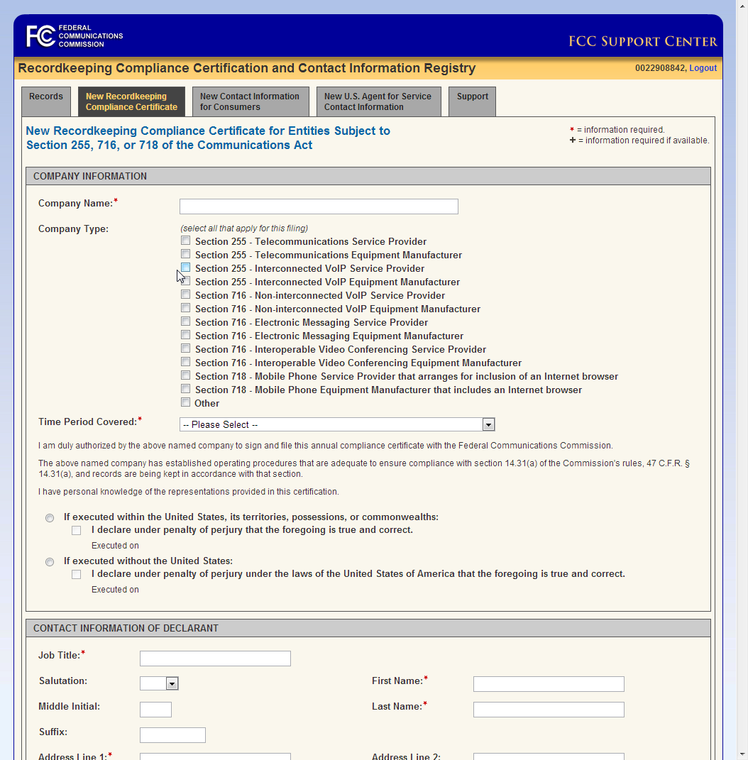
Certification
Filing occurs online via the RCCI Registry system:
https://apps.fcc.gov/rccci-registry/login!input.action
Application provides for the creation and signature of certification online
Identification via FCC Registration Number [FRN]

Slide 53
Enforcement

Slide 54
Enforcement
This is the CVAA
CVAA regulations are enforced by the FCC and can result in forfeitures up to $100,000 a day and $1,000,000 dollars in total for each complaint; common carriers also subject to damages
Decentralized governance runs the material risk that a product will not develop or maintain the relevant records needed to defend complaint
In that event, should a complaint occur, the organization could find itself in the uncomfortable position of having certified to the FCC that records are being kept when, in fact, no such records exist. We would expect the FCC to react negatively to such a situation.
A basic governance model requiring that these records be filed centrally with a group under the authority of the certifying party would seem to meet the requirements of the FCC and ensure conformance to the process.
Pursuant to FCC rules, the company must designate a company representative that is authorized to resolve complaints as well as a designated agent for service of complaints

Slide 55
Governance Model
This is not Section 508
The CVAA implies a strong, central governance model for conformance
  Generally a materially different governance model than that currently used for accessibility
  Most organizations have a governance model that requires each service product line to maintain its own records for accessibility
  A central accessibility office may play a coordinating and supporting role across the organization, but typically has no authority to compel product groups to produce documentation
Current approach was developed under and aligns well with accessibility procurement laws such as Section 508
Section 508, however, has no enforcement mechanism, as it relates to service providers and manufacturers and is a procurement law
  Reality – it’s a pretty low risk law with spotty enforcement
  Worst case scenario – organizations don’t buy your product

Slide 56
Products and Services
Recordkeeping Requirements

Slide 57
Functionality Questionnaire
Functionality Questionnaire
Develop a basic functionality questionnaire that covers all the potential product/service features that are covered under Sections 255, 716 and 718 of the Communications Act
If the product or service has functionality that answers “yes” to any of questions
  Complete a more extensive compliance and record keeping process for the covered functionality.
If the product or service answers “no” to all questions
  Then the completed questionnaire can be submitted to the organization's record-keeping repository and the product can exit the process.

Slide 58
Functionality Questionnaire
Functionality Questionnaire – Examples
Is the product a fixed-line telephone or telephone-like device?
  E.g. Polycom VOIP Phone, Touch Tone Phones
Is the product a mobile telephone?
  E.g. iPhone, Samsung Galaxy
Does the product or service provide for text messaging, instant messaging, e-mail or other text based communication?
  G-mail, Yahoo mail, Outlook web client, AOL Instant Messenger, iMessage, branded web-based email provided through a service providers site
Does the product provide for voice based communication?
  Inter connected VoIP (such as offered by cable MSOs), Skype, Google Talk, Facebook Chat
Does the product provide for video based communication?
  (Also) Skype, Google Talk, Facebook Chat

Slide 59
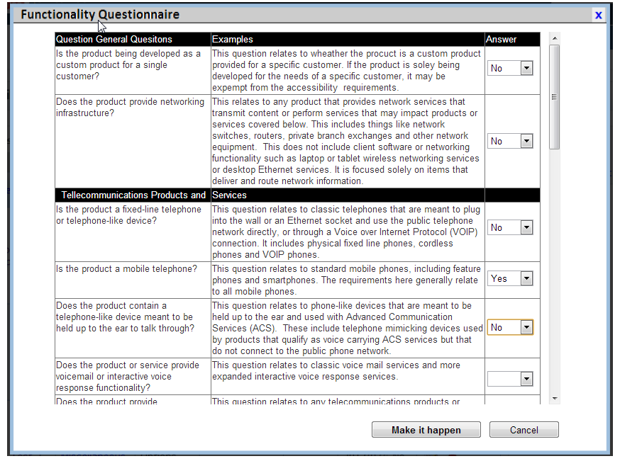
Functionality Questionnaire
Considerations
Limit the numbers of questions to products that are relevant to the organization
Provide examples that can be recognized by product teams
Decide if CVAA Title II – Video (47 CFR 79) covered products and services will go through the same process – if so add relevant questions
  Not subject to recordkeeping requirements
  Likely subject to accessibility requirements
Ideally this is a ten minute process with conservative “pass” approach
  If regulation could, reasonably, apply we review the system

Slide 60
Design Checklist
Design Checklist
Provide a list of best practices that a system must implement to be usable by people with disabilities and meet the implementation requirements of the relevant regulations.
The core criteria used for this are the relevant portions of the CFR that relate to the CVAA, including 47 CFR 6, 7, 14
  Can add 47 CFR 79 but this is generally not currently covered by recordkeeping requirements and derives from Title II of the CVAA.
Checklists will cover all of the best practices related to the technology platform used in the product.
Checklists should cover all the core development platforms
  Web, iOS, Android, Embedded Software, Windows Software, Hardware, ACS Services, etc.
Don’t try to build this yourself – recommend licensing this from a qualified vendor
  Subject matter is complicated and changes rapidly

Slide 61
Design Checklist
Design Checklist
Define a method of implementation for each requirement on the checklist:
Native Implementation – Best practice will be addressed directly in the product, i.e., built-in
Accessibility API – The best practice will be implemented by supporting the relevant OS or platform level accessibility API
Third-party – The best practice will be addressed through the use of third-party accessibility solutions, available to consumer through covered entity at nominal cost
  Triggers a need to support the third party solution
Non-Achievable – Conformance with the best practice is “not achievable” as defined by the CVAA.
  Triggers a need to provide secondary documentation surrounding the determination of non-achievability
Not Applicable – Best practice is not applicable in context of the product

Slide 62
Design Checklist - Timing
Design Checklist - Timing
As part of the FCC accessibility requirements, products and services must ensure that accessibility is considered and evaluated as early as possible in the product development life cycle.
Covered entities are directed to complete an accessibility evaluation as part of the design phase of the product (47 CFR §6.7, 7.7 and 14.20(b)), and to ensure that the accessibility requirements defined for the product/service are addressed as early as possible in the development process
As noted earlier this is often in contrast with current accessibility governance models where accessibility is considered after the fact

Slide 63
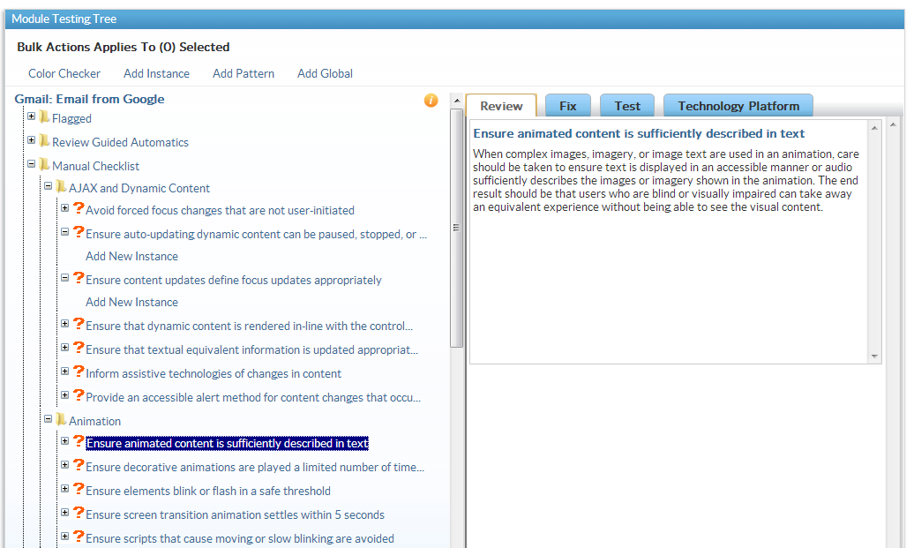
Design Checklist
Approach One – Design Comp Review
Audit design comps, prototypes and specifications for the system
Essentially a system audit performed against the design assets of the system
Create a audit report covering potential issues based on design
During implementation ensure each of the potential issues is addressed
Common “outsourced” approach
Example Design Checklist

Slide 64
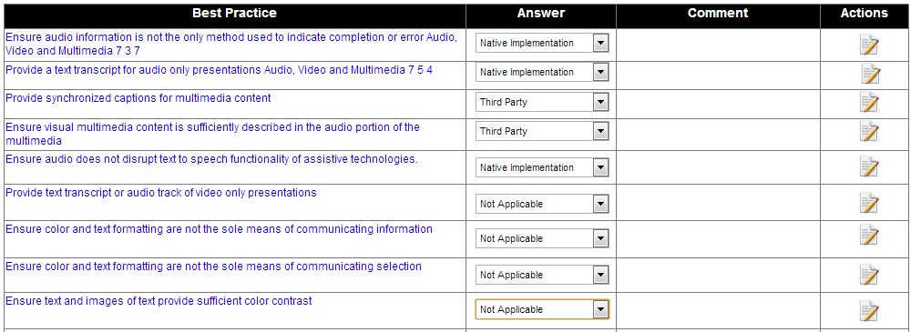
Design Checklist
Approach Two – Utilize Structured Checklist
Product team reviews each best practice and commits to a method of support
Requires explicit sign-off on each requirement from product team
Selected method of compliance can be used to help shape future audits and trigger further compliance activities
Common “in-house” approach
Notes:
Define a method of implementation for each requirement on the checklist:
Native Implementation – Best practice will be addressed directly in the product, i.e., built-in
Accessibility API – The best practice will be implemented by supporting the relevant OS or platform level accessibility API
Third-party – The best practice will be addressed through the use of third-party accessibility solutions, available to consumer through covered entity at nominal cost
Triggers a need to support the third party solution
Non-Achievable – Conformance with the best practice is “not achievable” as defined by the CVAA.
Triggers a need to provide secondary documentation surrounding the determination of non-achievability
Not Applicable – Best practice is not applicable in context of the product

Slide 65
Design Checklist
Considerations – Simplicity and Expense
The process is not simple
  Accessibility is complex and requires a significant amount of domain expertise to evaluate and implement
  Simplifying design checklists and evaluation approach is likely to result in gaps in coverage under 47 CFR 6,7, 14 and 79
  A core hurdle for an organization is understanding this is expensive to build in and requires material time, energy and budget to do properly
  Often when lines of business understand the level of effort they move towards a outsourced approach coordinated through the central program office

Slide 66
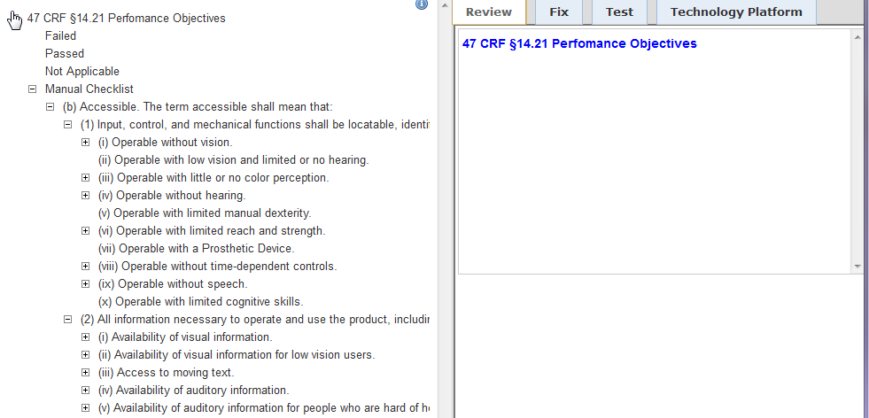
Design Checklist
Considerations – Using Regulatory Language
Checklists organized around regulatory language are far more difficult to use than checklists organized around best practices
Regulations are written around user modalities not design and development requirements
Provide alternative text for images is far more specific and actionable then Ensure operation without vision
  Best practices supported by code examples, reference technical standards, and test cases
  Mapped to regulatory language for justification
  Mapped to widely used accessibility standards for context and justification

Slide 67

System Assessments
Requirements for Compliance Auditing
Technical Requirements
Requires a system to have a conformant technical implementation
Testing requirements are split between those that can be tested Automatically (24.8%), Manually (48.3%) and Globally (26.9%)
Automatic testing is the cheapest and most common testing but covers only a small fraction of legal requirements
Functional Requirements
Requires a system to be usable to people with disabilities using current assistive technologies
Functional testing coverage for sensory and mobility impairments is generally required
Support Requirements
Requires a system to be accessible in deployment
Notes:
67
There are three questions that you have to be able to answer in the affirmative if you are to be considered compliant?
Did we write the application in a fashion that conforms to the coding requirements in the relevant standards? (Technical Requirements)
Can people with disabilities using the application complete the core tasks of the application? Alternatively, does the application as a whole produce an accessible experience? (Functional Requirements)
Is the deployment context of the application accessible? Does the information, documentation, support and training produce an accessible experience? (Support Requirements)
Technical Requirements
Automatic tests are requirements that can be tested for automatically with a high degree of certainty. Automatic testing can cover around 25% of applicable accessibility requirements the rest of which need to be tested manually or globally. Automatic tests generally don’t allow you to full determine compliance with the laws, for example:
Tools can test for the presence of alternative text but not if the text is a meaningful replacement
Tools can test for the presence of form field labels but not if assistive technology users can fill out a form
Manual testing relates to the issues that can be validate on a page-by-page (module-by-module) basis but can’t be validate across the entire application. All requirements that don’t fit the automatic profile are by nature manual requirements.
Global testing relates to the issues that can be tested once or a small number of times and extrapolated across the entire application
Things to think about when determining technical requirement testing coverage:
What automated testing tool do you currently have in place?
Do you have a checklist in place for global and manual testing? How long and detailed is the checklist?
How do you store the results for your global and manual testing?
Functional Requirements
Functional requirements have to do with the usability of the system by individuals with disabilities.
Technical requirements focus on the trees – functional requirements on the forest.
Things to think about when determining technical requirement testing coverage:
What individuals with disabilities do you use to test applications?
Do you have individuals who are blind testing your application with JAWS 10? Window-Eyes 7?
How do you capture new requirements as they are found in functional testing?
AN APPLICATION MUST CONFORM TO BOTH THE TECHNICAL AND FUNCTIONAL REQUIREMENTS TO BE COMPLIANT
Support Requirements
Is the documentation of the application accessible?
Do I have means of providing accessible support for the application? TTY / TDD? Accessible online chat?
Is the training that supports the application accessible?

Slide 68
System Assessments
Groundwork
Testing
Reporting
Identify
Modules
Analysis
Automated
Global
Manual
Prioritization
Identify
Use Cases
Authoring
Assistive Technology
Delivery
SSB utilizes a Unified Audit Methodology to provide a single method to create audits for organizations covered by CVAA requirements
Provides a single, unified process for auditing all technology platforms and relevant standards
Testing coverage for full compliance requirements
Repeatable and scalable testing methodology
Code level remediation guidance
As needed independent validation and verification of compliance
Creation of CVAA specific record keeping requirements
Notes:
The testing process is broken down into three key phases – Groundwork, Testing and Reporting. The Groundwork and testing phases have two tracks – normative testing which validates the application against a set of best practices and functional testing which validates the overall use of the application.
Groundwork - During the groundwork phase, the actual portions of the system that are identified and prepared for the different forms of testing that are performed by SSB. The testing scope includes two key components - the module list and the use case list. The modules that are selected are a "representative" set of interface components - pages, screens, visual components, controls, etc. - that are found in the system. These are the modules that will be tested with SSB's exhaustive automated, global and manual testing methodology which collectively defines our normative testing approach. The use cases reflect a representative set of "core tasks" that are performed by users of the system. Each use case is formally scripted to define the sequence of steps that the user performs to complete that task. These are the core tasks that users with disabilities will test with the leading assistive technologies. The lists of modules and use cases are somewhat independent of each other, but the most important or complex features of the system will be reflected in both lists.
Testing - Once the lists of modules and use cases have been finalized by SSB and approved by the client, our team will test the system using SSB's proprietary methodology. The testing is broken into two broad categories. Normative testing utilizes automated testing tools where they are viable, global issue review and manual testing. The Normative testing approach general maps to the Section 508 technical standards previously discussed. Functional Testing includes testing by individuals that are blind or disabled using the leading assistive technologies. This functional testing approach generally maps to the Section 508 functional requirements previously discussed. In this fashion we can determine both the technical and functional compliance of the application in one testing process.
Reporting
Analysis - After the completion of the testing phase SSB's testing team will cross-validate the manual, use case, and automated testing results and synthesize them into a single compliance data set. The data set will then be analyzed for violations that occur in patterns as well as in isolation, and will map specific violation descriptions against the modules on which each was found. The analysis phase also translates the large amounts of raw data produced in the testing phase into a clear, concise, prioritized set of recommendations. This ensures that recipients of the report receive not just a list of issues but a prioritization defining what issues are most important to address first.
Delivery – Finally SSB presents the report online or onsite to all relevant stakeholders across applicable functional groups. This presentation serves to raise awareness of compliance within the product groups and allow for the clarification of report findings across all affected functional groups.

Slide 69
Functional Testing
Functional Evaluations – Requirement
User testing of the product/service by individuals with disabilities
Ensures (i) user input into the development process and (ii) to provides validation of the use of the system in supported assistive technologies
Strongly implied requirement under 47 CFR 14.21 (a) – Accessible
Hard requirement of 47 CFR 14.31 (a) (1) and (3)
Broad industry consensus that testing with users with disabilities is a requirement for ensuring accessibility
Materially the same concept define in 36 CFR 1194.31 requirements of Section 508 with broader scope
Example Report

Slide 70
Functional Testing
Functional Evaluations - Approach
Execute a set of core use cases by individuals with disabilities to determine if users can complete core tasks in the system
Use cases are constructed as simple acceptance tests performed by users of assistive technologies
Functional assessment should be completed in conformance to the use case testing methodology provided as part of SSB’s Unified Audit Methodology
Testing performed in assistive technologies that meet the definition of nominal cost

Slide 71
Accessibility Features Document
Accessibility Features
Based on assessment results and product development activities organizations develop a list of “features” that support accessibility
SSB recommends the features document state the compliance issues that were found in the assessment and subsequently fixed in the product
Features document should be cumulative across releases
  As the product/service implements more accessibility requirements this should be reflected in the document

Slide 72
Accessibility Features Document
Accessibility Features
A publicly available features document is required under usability requirements of performance objectives (47 CFR 14.21 (c))
Can be the same document used to satisfy the recordkeeping requirements or a shorter document for public consumption
For ease of maintenance SSB recommends a single document be used for both requirements
Similar in construction to requirement under 47 CFR 1194.41 (b)

Slide 73
Accessibility Features Document
Content
Overview – High level information about organization’s commitment to accessibility
Contact Information – How to get in touch with organization if there are questions or accessibility concerns
  Provide a clear method of addressing accessibility issues ideally without getting regulatory authorities involved
Accessibility Features – Specific accessibility features in the product
Supported Assistive Technologies – Product supported assistive technologies – generally those that meet the definition of nominal cost
Additional Resources – Other relevant resources from the organization
Keyboard Shortcuts – Standard and supported keyboard shortcuts for product or service

Slide 74
Recordkeeping Repository
SSB recommends that organizations maintain a central repository of the product records that are maintained for each product or service that is covered under the CVAA.
This central repository should be maintained by a single group – generally compliance - that has the authority to require and compel products to submit the relevant paperwork
We see such a centralized approach as the clear implication of certification requirement for an officer with “personal knowledge of the representations provided in the company's certification”
The legislative and regulatory intent aligns with this – the goal of the recordkeeping is accountability

Slide 75
Sam Joehl
Sam.Joehl@ssbbartgroup.com
See more webinars in the CVAA Series and others at:
www.ssbbartgroup.com/webinars.php
Check out more CVAA content:
https://www.ssbbartgroup.com/reference/index.php/Accessibility_Laws_and_Standards

